Slide 1
Fundamentals of software architecture
Csaba Lámfalusi
CONFIDENTIAL | © 2019 EPAM Systems, Inc.

Slide 2

Csaba Lámfalusi
Senior Software Engineer at EPAM
Current Project Role: Development Lead
Primary Skill: Java Backend Development
Advanced experience in Enterprise Web Application development.
Using Spring Framework
Other interest: Big Data Technologies
Hadoop, Hive, Apache Spark
Contact
csaba_lamfalusi@epam.com
www.linkedin.com/in/csaba-lámfalusi

Slide 3

Agenda
1
Introduction
2
Thinking Architecturally
3
A Design Process: A Brief Introduction
4
Broad Architectural Patterns

Slide 4
Introduction

Slide 5

Architect (noun)
Designer of complete systems
Describes a person
Architects design things (complete systems)
Without every details (fill the implementation)
The focus is on the structure

Slide 6


Architect
User problem
Architectures describe entire structures, systems in software with a purpuse
Effective architectures reflect the needs of the customer and the domain or business
Computer systems solve real word problems
The best arcthitectures reflect the structure of that real world
Never start with the implementation step like
Programing language
Database server
Start with the user problem and then figure out the best way to solve it
The implementation technology comes last
Arcthitect
Customer
Implementation
6

Slide 7
Architect
Traditional (waterfall organization)
Modern (agile)
Conceives the perfect design
Spends months or years producing big up-front design
Drawbacks
Big and complex designs
Code is written after design
Doesn’t capture the users’s true needs
Doesn’t allow for learning
Lack of flexibility
Painful bureaucratic processes
Not following the design
Random improvisation
Slow development process
Centralized architect-making decisions
Doesn’t want to settle on a particular design too soon
You’ll learn about the problems as you solve them
Instead of it
Build very small things
Release them constantly
Evolve based on feedback
Prefers incremental design
Notion of experimentation
If you are not sure, run an experiment
If experiment succeeds, adopt
If it doesn’t throw the code and the architectute
Looks at rebuilding as less costly than building the wrong thing
Part of the team: teaching, coaching, coordinating
Notes:
Traditional architect drawback IBM case study:
Project: U.S. Air Traffic control system
After one year desinging the system became out-dated
The hardware and the air traffic control practices had moved on
They started over and came up another design
It became out-dates again
They were doing in 10 years and nothing was built

Slide 8
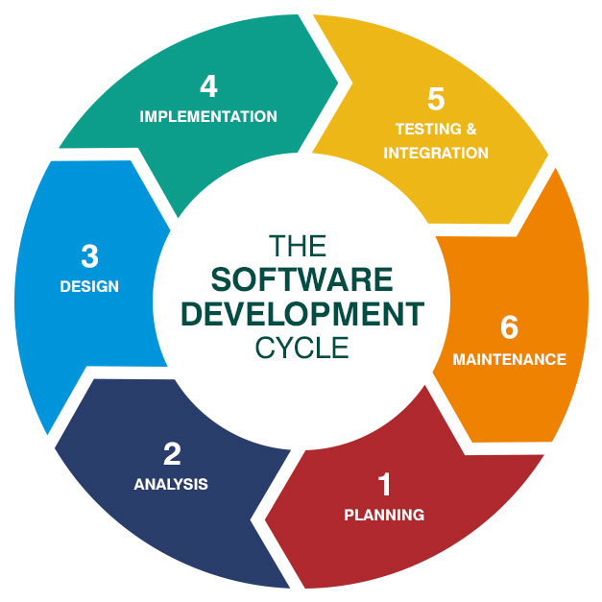
The software development cycle
CONFIDENTIAL | © 2019 EPAM Systems, Inc.

Slide 9
“In most successful software projects, the expert developers
working on that project have a shared understanding of the
system design. This shared understanding is called
‘architecture.’ This understanding includes how the system is
divided into components and how the components interact
through interfaces. These components are usually
composed of smaller components, but the architecture only
includes the components and interfaces that are understood
by all the developers.” - Martin Fowler

Slide 10
„Architecture is about the important stuff.
Whatever that is.” - Martin Fowler

Slide 11
Thinking Architecturally

Slide 12
„Any organization that design a system will inevitably produce a design whose structure is a copy of the organization’s communication structure.” – Mel Conway

Slide 13



Siloed Organization
DBAs
UI/UX team
Business Specialist
Database Layer
UI Layer
Business Logic
CONFIDENTIAL | © 2019 EPAM Systems, Inc.

Slide 14

Conway’s Law
Change the structure of the organization to match agile methods.
Instead of horizontal silos
Cross-functional teams
Have all of the skills
Own complete vertical slice of the system
Moving to agile-friendly architectures
It lets the team work faster

Slide 15
Incremental vs. big up-front design
Big Up-Front Design (BUFD)
Agile Incremental Design
User interface
Customer
Business logic
Stories
Database
Technology

Slide 16



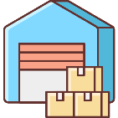
Domain-Driven Design
The structure of your code should map to the structure of the problem domain
DDD-based systems are rarely N-Tiered systems because tiers are technical things (they don’t model any part of the domain)
Unique architectures to solve unique problems
The modules reflect the business, not the implementation technology
Subsystems might use completely different implementation technologies
Bounded context models natural divisions within the buiness whose problems we’re solving, the domain
The communication is focused on the work that happens in the given context
In the BUFD we try to come up with the universal model
Storefront
Invoice
Payment
Warehouse

Slide 17
A Design Process: A Brief Introduction

Slide 18
Requirements gathering
Problem statement
User Story
Describes the end user’s problem
Describes the solution to the problem
Describes their work (not yours)
Describes an end user going through a domain-level process to achieve some valueable outcome
Does not describe a computer program
If you not providing actual value, solving some real problem, that one of your real users has in the real world, why would anybody want to use the software?
Stories need to be refined

Slide 19
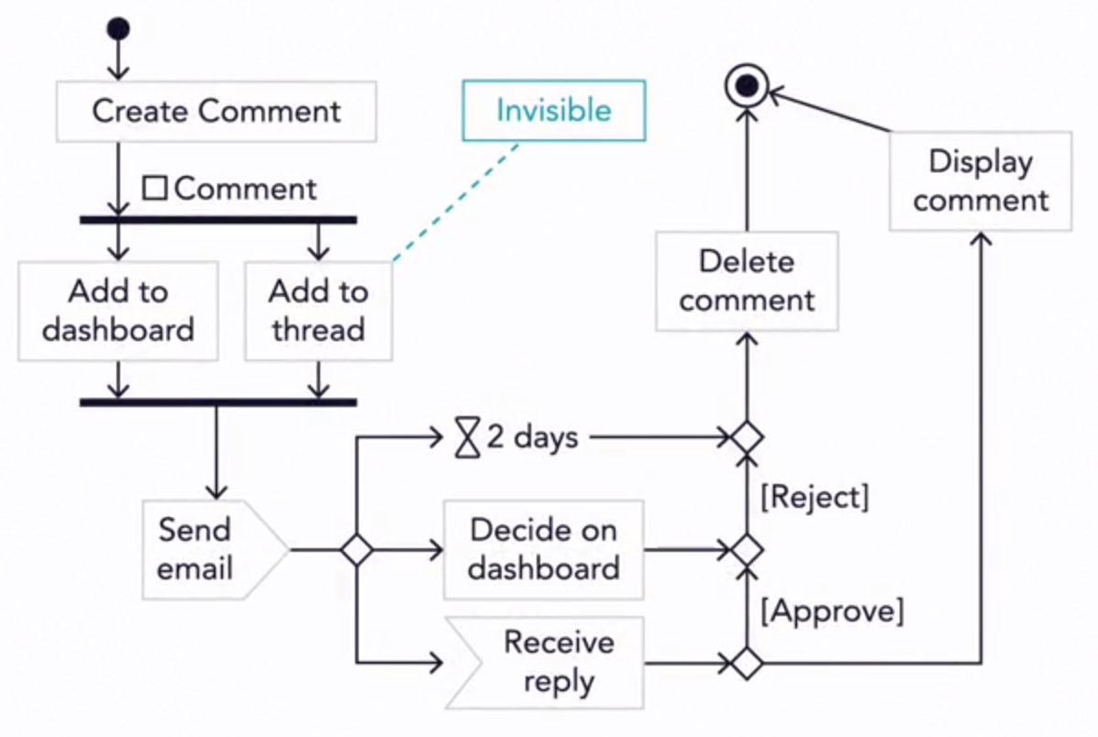
Narrowing
horizontal
Vertical
Story
User interface
Business logic
Database

Slide 20
Broad Architectural Patterns

Slide 21
Monoliths
The entire program is one large executable unit
Specified with hundreds and tousands of lines of source code
Mostly N-Tiered applications
Vetical and horizontal divisions
Strengths
Homogeneous structure
Challenges
Homogeneous structure
Nobody understands the whole program
Long test-and-deploy process
Agility is nearly impossible

Slide 22
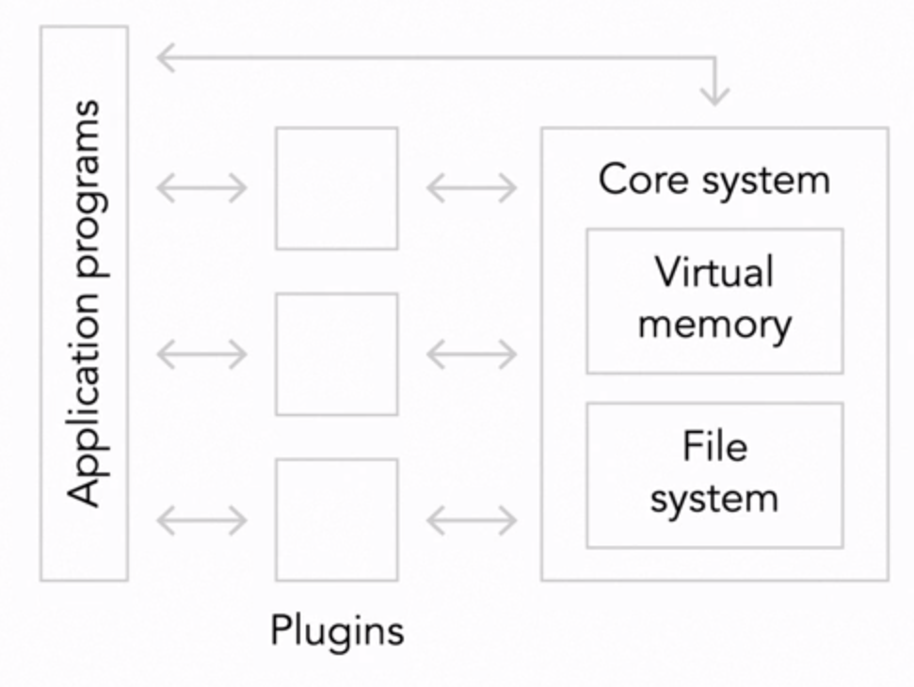
Microkernel (plugin) architectures
A Step up from a pure monolith
The first microkernel realization was an operating system
The idea is to put essential capabilities of your system into
a single stand-alone executable called the kernel
Strangths
Isolation prevents big ball-of-mud dependencies
Plugin are small and easy to write, debug and maintain
Challenges
APIs to the kernel are delicate
New APIs may require re-writing plugins
Problems within a kernel can bring the system down
Plugins are indirectly coupled through the kernel

Slide 23
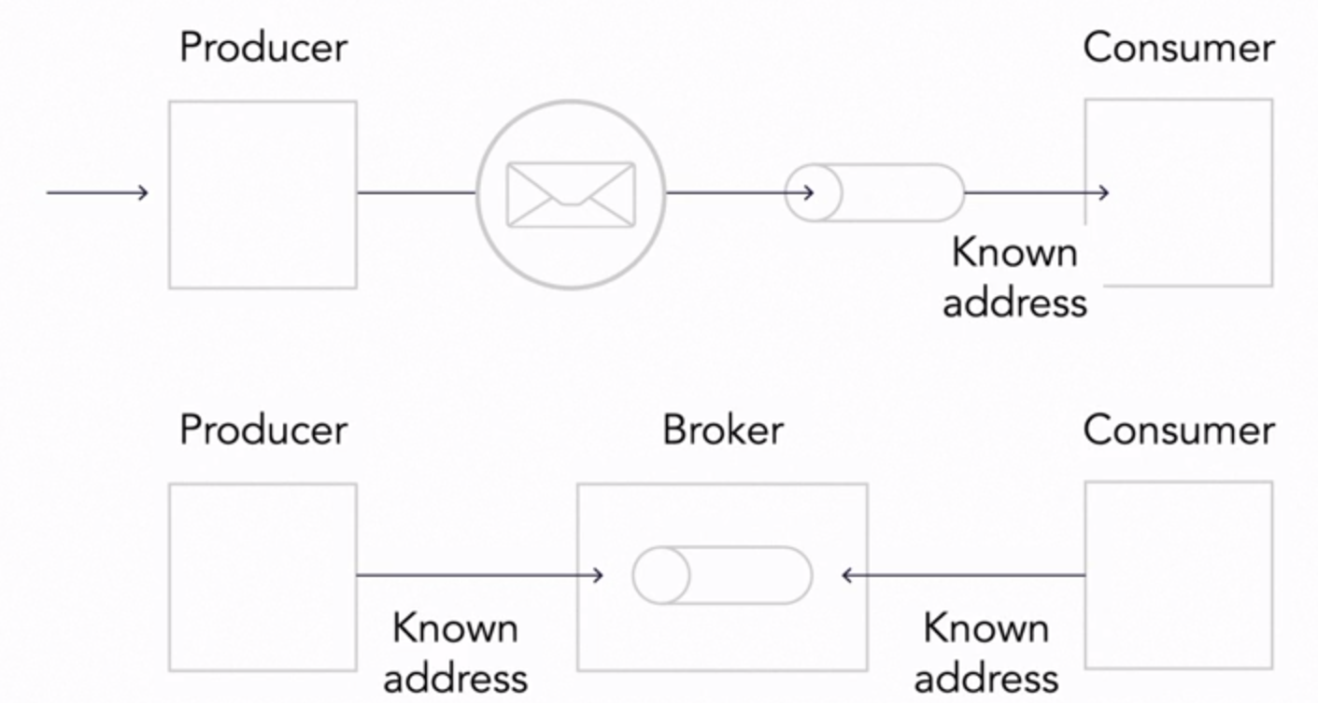
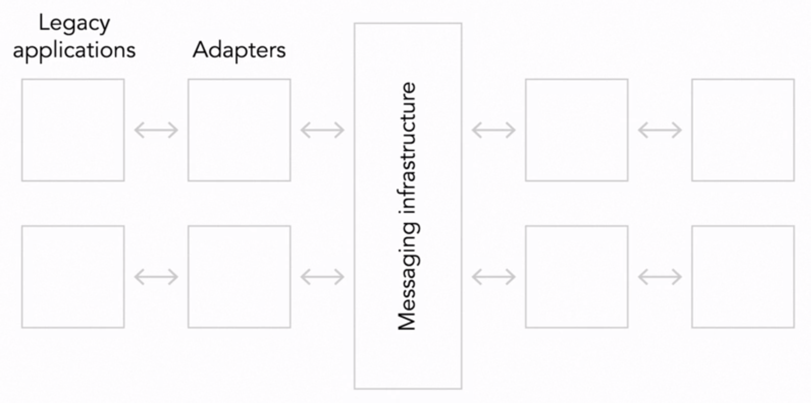
Message-based architectures
Formalizing the communication paths between elements and isolating them
Ease problems associated with network communication
Forge into a single system things that aren’t designed to work together
A common message bus control the flow of communication
Publish / Subscriber model
Strengths
More maintainable than monolith
Solve dependency problems in microkernel systems
Challenges
Managing a highly complex system
Can be very slow and time consuming
Messages have to be stored on disk, replicated, backed up and so on

Slide 24
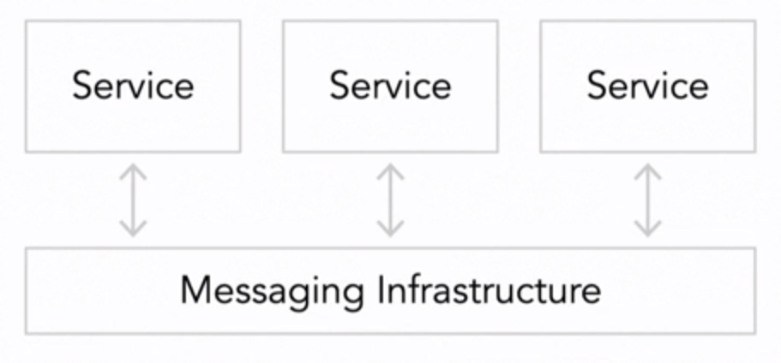
Microservice and miniservices
The large system is made up of a cloud of very small independent services that
cooperate as peers to get the larger work done
Supports distributed deployment and complex real-time interactions
Main requirements
Small (few hundred lines of source code)
Independently deployable
Fully autonomous
Hides implementation details
Distributed
Highly observable
Modeled around business concepts
Strengths
Independent services
Changes do no affect the rest of the system
Changes can occur quickly
Challenges
Design and runtime complexity
Network are slow compared to alternatives

Slide 25
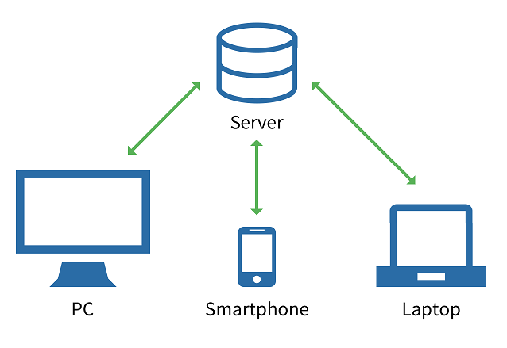
Client-Server Architecture

Slide 26
REST
Representational State Transfer
Defined by Roy Fielding in his 2000 PhD dissertation
Very popular architectural style for designing web services
Most commonly used over HTTP with JSON payload
Lightweight alternative to SOAP web services
Things vs. actions
Nouns vs. verbs
Web Service API
Adhering to REST constrains
Defines a set of architectural constraints
Client - Server architecture
Stateless
Cache
Uniform interface
Layered system
Code on demand (optional)
HTTP based
Accessible on a base URI (http://localhost:8080/message/1)
Provides an Internet Media Type (JSON, XML, image etc.)
Implements standard HTTP methods (CRUD: POST, GET, PUT, DELETE)

Slide 27
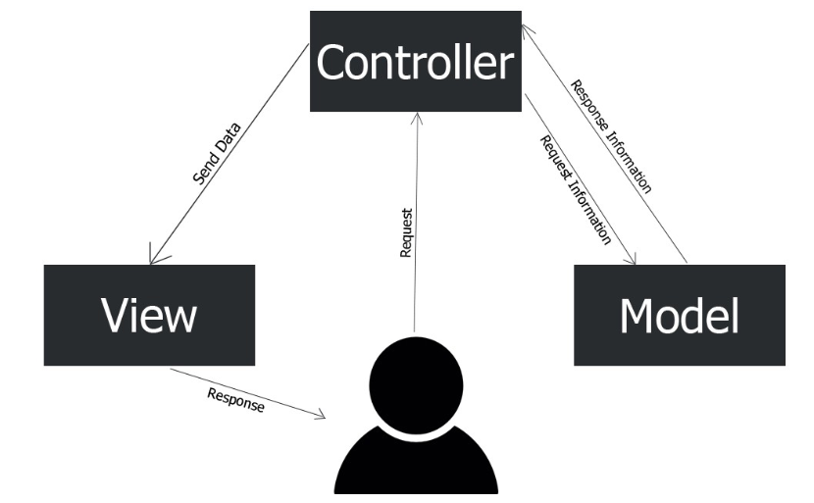
MVC
Model-View-Controller

Slide 28
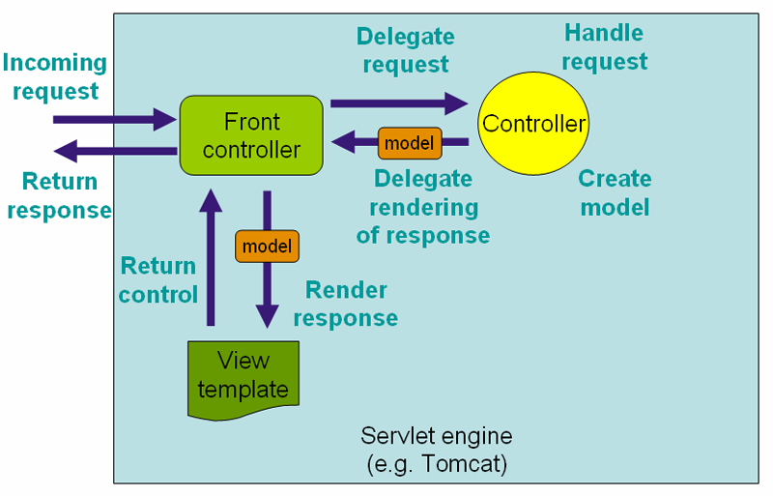
Front Controller
Spring MVC Model

Slide 29
Thank you for your attention

